Slide 1
Python Collection Objects, Classes
Module 2
3rd Semester MCA

Slide 2
Strings
Creating and Storing Strings,
Basic String Operations,
Accessing Characters in String by Index Number,
String Slicing and Joining,
String Methods,
Formatting Strings,
Lists
Creating Lists,
Basic List Operations,
Indexing and Slicing in Lists,
Built-In Functions Used on Lists,
List Methods
Sets, Tuples and Dictionaries.
Files
reading and writing files.
Class
Class Definition
Constructors
Inheritance
Overloading

Slide 3
Strings
A string consists of a sequence of characters, which includes letters, numbers, punctuation marks and spaces.
Creating and Storing Strings :
Created by enclosing text in single and double quotes.
Triple quote can be used for multi-line strings.
>>> S='hello'
>>> Str="hello"
>>> M="""This is a multiline String across two lines""“
contains backslash and don't want it to be treated as an escape character, called raw string. Is created by prefixing a string literal with 'r' or 'R‘.
>>> s= r" world health \n organization"
>>> print(s)
world health \n organization

Slide 4
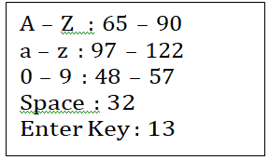
Basic String Operations
Concatenation can be done:
using + operator : str3 = str1 + str2
placing strings side by side : str= 'this' 'is' 'python' 'class'
The in operator :
Is a Boolean operator which takes two string operands.
Ex: if 'pa' in “roopa:
Ex: if ';' not in “roopa”:
Ex:3 we can avoid writing longer codes like this
if t=='a' or t=='e' or t=='i' or t=='o' or t=='u':
instead we can write this code with ‘in’ operator
if t in 'aeiou‘:
String comparison
< (less than), > (greater than), == (equals) etc
Results in a Boolean value True or False
Comparison happens using ASCII codes
Ex:2
if word < ' Ravindra':
print('Your name,' + word + ', comes before Ravindra.’)
elif word > ' Ravindra':
print('Your name,' + word + ', comes after Ravindra.’)
else:
print('All right, Ravindra.')

Slide 5
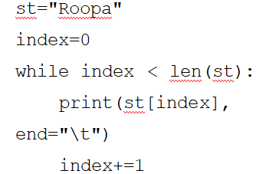
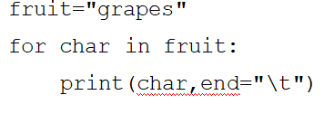
Traversal through a string with a loop
Extracting every character of a string one at a time
Performing some action on that character
while loop
for loop
Accessing Characters in String by Index Number
single character in a string using an index
specified in []
integer and starts at zero
word = 'Python'
>>> word[0] # character in position 0
'P‘
negative indexing of string starting from the end of the string

Slide 6
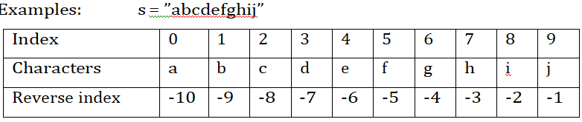
String Slicing and Joining
String slices :
A segment or a portion of a string is called as slice
extracted from a string using colon (:)
The basic syntax for slicing a string :
String_name[start : end : step]
Where,
start : the position from where it starts
end : the position where it ends
step: Is used to indicate num of steps
to be incremented.Default is 1.

Slide 7
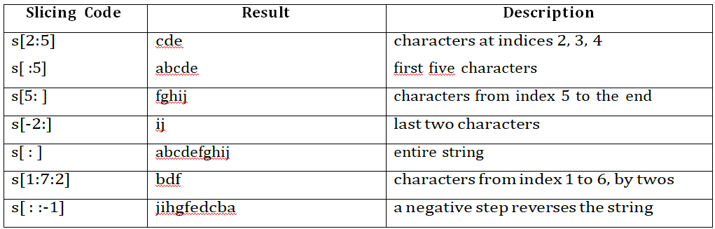

Slide 8
String Method
capitalize() Converts the first character of the string to a capital (uppercase) letter
find() Returns the lowest index of the substring if it is found
strip() Returns the string with both leading and trailing characters
lstrip() Returns the string with leading characters removed
rstrip() Removes trailing characters
casefold() Implements caseless string matching
startswith() Returns “True” if a string starts with the given prefix
endswith() Returns “True” if a string ends with the given suffix
lower() Converts all uppercase characters in a string into lowercase
upper() Converts all lowercase characters in a string into uppercase
join() Returns a concatenated String
count() Returns the number of occurrences of a substring in the string.

Slide 9
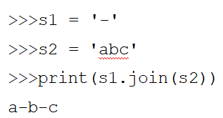
String Methods
capitalize() : print(msg.capitalize())
find() : s.find(sub[, start[, end]]) -> int print(st.find(‘x’))
strip() : print(st.strip())
strip(chars) : print(st.strip(‘#’))
rstrip() : remove whitespace at right side
lstrip() : remove whitespace at left side
casefold() : caseless comparisons
split(“separator”) : s="a,b,c,d,e”print(s.split(",")) [‘a', ‘b', ‘c', ‘d‘, ’e’]
startswith(prefix, start, end) : print(str.startswith("L"))False
join() : Concatenate.
lower(),upper(),replace(x,y)
count(x),index(x)
isalpha()

Slide 10
Formatting Strings
format operator : “%d” to format an integer, “%g” to format a floating point number and “%s” to format a string:
f-string :
prefixed with “f”,
Replacement fields, which are expressions enclosed within curly braces {}.
a=10
print(f”the value is {a}”)
the value is 10
format( ) function :
positional_argument : print("{0} college{1} ".format("SDIT",“MCA"))
keyword_argument: print(“MCA department {0} ‘D’.format("6", college=“SDIT"))

Slide 11
strings
A string is a sequence of characters.
For example, the English language has 26 characters.
Computers do not deal with characters, they deal with numbers (binary).
This conversion of character to a number is called encoding
the reverse process is decoding

Slide 12
example
#checking data type
string='hello'
type(string)
--------------
Output:
str

Slide 13
Example:reading string from user
#reading string
string=input("enter the string")
print(string)
------
enter the string good morning have a nice day good morning have a nice day

Slide 14
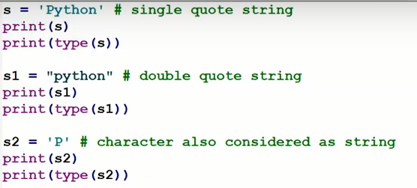

Slide 15
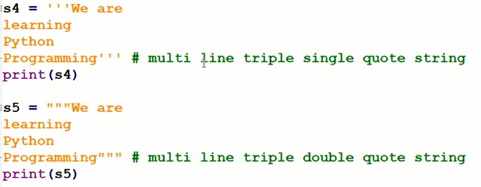

Slide 16
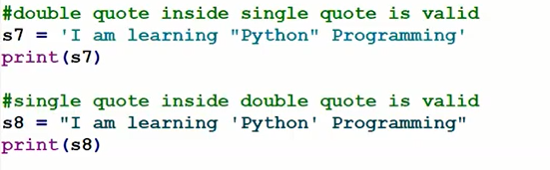

Slide 17
Traversal with a for loop
Accessing character(s)
Example:
#traversal with for loop
message='hello!'
index=0
for i in message:
print("message[",index,"]=",i)
index+=1

Slide 18
output
message[ 0 ]= h
message[ 1 ]= e
message[ 2 ]= l
message[ 3 ]= l
message[ 4 ]= o
message[ 5 ]= !

Slide 19
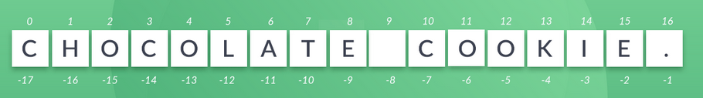
String Slicing in Python

Slide 20
example
#slicing example
snack = "Chocolate cookie."
print(snack[0])
print(snack[9])
print(snack[-1])
-------------------
#slicing example
snack = "Chocolate cookie."
print(snack[4])
print(snack[9])
print(snack[-2])

Slide 21
String slices
A segment of string is called a slice
Just like selecting character
The syntax for range slicing is the following:
[Start index (included): Stop index (excluded)]
Ex1:
#string slice
s='hello python'
s[0:7]
Output:
'hello p'

Slide 22
Continue.
#slice2
fruit='banana'
fruit[:3]
Output:
'ban‘
---------------------

Slide 23
Continue..
#slice3
fruit='banana'
fruit[3:]
Output:
'ana‘
-----
#slice3
fruit='banana'
fruit[3:3]
Output: ‘’

Slide 24
Strings are immutable
Once strings are created cant be changed.

Slide 25
String concatenating
Joining together
+ operator
Example:
#string concatenation
str1='hello'
str2='python'
str3=str1+str2
print("the concatenated string is:",str3)
Output:
the concatenated string is: hellopython

Slide 26
example2
#concat 2 strings
string1 = input("enter the first string")
string2 = input("enter the second string“)
full_name = string1 + " " + string2
print(full_name)

Slide 27
example3
#error_example
cost = 15
string1 = "The total in Euro is: “
bill = string1 + cost
print(bill)

Slide 28
Error message
TypeError Traceback (most recent call last)
<ipython-input-6-bdea940ccf25>
in <module> 2
string1 = "The total in Euro is: "
bill = string1 + cost
print(bill)
TypeError: can only concatenate str (not "int") to str

Slide 29
correction
#correct code
cost = 15
string1 = "The total in Euro is:”
bill = string1 + str(cost)
print(bill)
----------------
Output:
The total in Euro is: 15

Slide 30
String append
Add something at the end.
+= operator used
#program to append string
str="hello\t"
name=input("enter your name:")
str+=name
str+=".welcome to python programming."
print(str)
Output:
enter your name:abhishek
hello abhishek.welcome to python programming.

Slide 31
Multiply() in strings
* operator: used for reapeat string n number of times.
Example:
#dot operator in string
str='hello'
print(str * 3)
output:
hellohellohello

Slide 32
Searching
It takes a character and finds the index where that character appear.
If character not found , the function returns -1.
Traversing a sequence and returning

Slide 33
Looping and counting
#example looping with counting
word ='banana'
count=0
for letter in word :
if letter == 'a':
count=count+1
print(count)

Slide 34
String methods
Performs variety of useful operations.
Similar to functions
Takes arguments and returns a value
upper():
word. upper()

Slide 35
example
#coverting upper case
word='banana'
new_word=word.upper()
print(new_word)
Output:
BANANA

Slide 36
find()
#coverting upper case
word='banana'
index=word.find('n')
print(index)
Output:
2

Slide 37
Built in functiuons
str.capitalize():
returns a copy of the string with its first character capitalized.
Example:
str.capitalize('cookie')
Cookie

Slide 38
str.islower():
returns true if all characters in the string are lowercase, false otherwise.
Example:
snack = 'cookie'
snack.islower()

Slide 39
Method | Description
capitalize() | Converts the first character to upper case
center() | Returns a centered string
count() | Returns the number of times a specified value occurs in a string
encode() | Returns an encoded version of the string

Slide 40
Method | Description
append() | Adds an element at the end of the list
clear() | Removes all the elements from the list
copy() | Returns a copy of the list
count() | Returns the number of elements with the specified value
extend() | Add the elements of a list (or any iterable), to the end of the current list
index() | Returns the index of the first element with the specified value
insert() | Adds an element at the specified position
pop() | Removes the element at the specified position
remove() | Removes the first item with the specified value

Slide 41
#remove punctuation
# define punctuation
punctuations = '''!()-[]{};:'"\,<>./?@#$%^&*_~'''
my_str = "Hello!!!, he said ---and went."
# remove punctuation from the string
no_punct = ""
for char in my_str:
if char not in punctuations:
no_punct = no_punct + char
# display the unpunctuated string
print(no_punct)

Slide 42
example
# define punctuation
punctuations = '''!()-[]{};:'"\,<>./?@#$%^&*_~'''
#To take input from the user
my_str = input("Enter a string: ")
# remove punctuation from the string
no_punct = ""
for char in my_str:
if char not in punctuations:
no_punct = no_punct + char
# display the unpunctuated string
print(no_punct)

Slide 43
Lists
A lists is a sequence
An ordered sequence of values
It is a data structure in Python
Values can be of any type: integer, float, strings, lists, tuples, dictionaries..
enclosed within square brackets.

Slide 44
Creating Lists
Basic List Operations : + *
List Aliasing : == , is
Indexing and Slicing in Lists :
Built In Functions
List Methods

Slide 45
Creating Lists:
L = [1,2,3]//square brackets to indicate the start and end of the list, separate by comma.
a = [ ] //Empty list,
l=list()
Long list can split it across several lines
nums = [0, 1, 2, 3, 4, 5,
6, 7, 8, 9, 10,11]
eval(input( )) L = eval(input('Enter a list: ')) // Enter a list: [5,7,9]
list and range function : num=list(range(10))
Nested lists : a = ['a', 'b', 'c'] n = [1, 2, 3] x = [a, n] || col=[23,[9.3,11.2,],[‘good’], []]

Slide 46
Basic List Operations
The plus (+) operator concatenates
a = a + [1, 3, 5] reassigns a to the new list [10, 20, 30, 1, 3, 5].
a += [10] updates a to be the new list [10, 20, 30, 1, 3, 5, 10].
the * operator repeats a list a given number of times
print([1, 2, 3] * 3) // [1, 2, 3, 1, 2, 3, 1, 2, 3]

Slide 47
List Aliasing
both of them will refer to same object in the memory
The association of a variable with an object is called as reference.
a = [10, 20, 30, 40]
b = [10, 20, 30, 40]
print('Is ', a, ' equal to ', b, '?', sep='', end=' ')
print(a == b)
print('Are ', a, ' and ', b, ' aliases?', sep='', end=' ')
print(a is b)
c = [100, 200, 300, 400]
d = c # creating alias
print('Is ', c, ' equal to ', d, '?',
sep='', end=' ')
print(c == d)
print('Are ', c, ' and ', d, ' aliases?',
sep='', end=' ')
print(c is d)
Output:
Is [10, 20, 30, 40] equal to [10, 20, 30, 40]? True
Are [10, 20, 30, 40] and [10, 20, 30, 40] aliases? False
Is [100, 200, 300, 400] equal to [100, 200, 300, 400]? True
Are [100, 200, 300, 400] and [100, 200, 300, 400] aliases? True

Slide 48
Indexing and Slicing in Lists
Indexing
The syntax for accessing the elements of a list using the bracket operator.
Accessing elements with negative index
Accessing the elements within inner list can be done by double-indexing
ls=[[1,2],['EC','CS']] //Output : EC
print(ls[1][0])
List slicing
Expression : list [ begin : end : step ]
Begin : defaults to 0, end : defaults to the length of the list, step: default is 1.
Left side of an assignment can update multiple elements

Slide 49
t = ['a','b','c','d','e','f']
t[1:3] = ['x', 'y']
print(t) //['a', 'x', 'y', 'd', 'e', 'f']
lst =[10,20,30,40,50,60,70,80,90,100]
print(lst)
print(lst[0:3])
print(lst[4:8])
print(lst[2:5])
print(lst[-5:-3])
print(lst[:3])
print(lst[4:])
print(lst[:])
print(lst[-100:3])
print(lst[4:100])
print(lst[2:-2:2])
print(lst[::2])

Slide 50
Built In Functions:
Len : returns the number of items in the list
Sum : returns the sum of the items in the list
Min : returns the minimum of the items in the list
Max : returns the maximum of the items in the list

Slide 51
List Methods
append : adds a single item to the existing list
extend : takes a single argument (a list) and adds it to the end.
Count : returns the number of times a given element appears in the list
Insert : new element before the element at a given index. Modiﬁes //ls.insert(1,"hi")
index : Returns the lowest index
Reverse : reverses the elements in the list. Modiﬁes.
Sort : ascending order. Modifies
Clear : removes all the elements, list empty
Deleting Elements: several ways to delete elements
pop() : removes the item at specified index p and returns its value
remove():if the index of the element is not known, then the value to be removed can be specified, will not return the value
del : when more than one item to be deleted at a time || del my_list[1:5]

Slide 52
Sets
Python provides a data structure that represents a mathematical set
we use curly braces { }
Are unordered and may contain no duplicate elements
Duplicate elements appear only once in the set
The expression { } does not represent the empty set.
Set must contain at least one element.

Slide 53
Creation of sets
>>> s = {10, 3, 7, 2, 11}
>>> s {2, 11, 3, 10, 7}
>>> t = {5, 4, 5, 2, 4, 9}
>>> t {9, 2, 4, 5}
s={10,20,30,40}
s={10,20,2.3,”abc”}
s={10,20,30,20,10,20,10}
s[1] //We cannot access element using index
s={10,20}
s.add(30)
print(s)
s.discard(20)
print(s)

Slide 54
List conversion using set()
>>> l = [10, 13, 10, 5, 6, 13, 2, 10, 5]
>>> s = set(l)
>>> s
{10, 2, 13, 5, 6}
The element ordering is not preserved, and duplicate elements appear only once in the set.

Slide 55
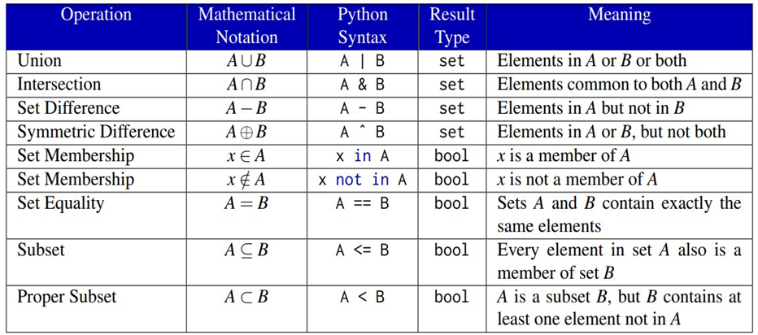
Basic operations using set

Slide 56
Cont.
Python reserves the { } notation for empty dictionaries
Python supports the standard mathematical set operations of intersection, union, set difference, and symmetric difference.
>>> S = {2, 5, 7, 8, 9, 12}
>>> T = {1, 5, 6, 7, 11, 12}
>>> S | T {1, 2, 5, 6, 7, 8, 9, 11, 12}
>>> S & T {12, 5, 7}
>>> 7 in S True
>>> 11 in S False

Slide 57
Tuples
A tuple is a collection of heterogeneous elements
Tuples are written with round brackets.
Tuple items are ordered, unchangeable, and allow duplicate values.
The values stored in a tuple can be any type, and they are indexed by integers
A tuple is an immutable list of values

Slide 58
Cont.
Creation :
Many ways to a tuple:
Accessing Elements in a Tuple
Tuples are immutable
Comparing tuples
Tuple assignment

Slide 59
example
#example for tuples
thistuple = ("apple", "banana", "cherry")
print(thistuple)
---------------------
output:
('apple', 'banana', 'cherry')
​

Slide 60
Allow Duplicates in tuples
tuples are indexed
they can have items with the same value
program:
#duplicated allows
thistuple = ("apple", "banana", "cherry", "apple", "cherry")
print(thistuple)
('apple', 'banana', 'cherry', 'apple', 'cherry')

Slide 61
Tuple Length
#Print the number of items in the tuple
thistuple = ("apple", "banana", "cherry")
print("the length of given tuple :",len(thistuple))
-----------------------
output:
the length of given tuple is: 3

Slide 62
data type of tuples
#checking data type
thistuple = ("apple",)
print(type(thistuple))
----------------------------
<class 'tuple'>

Slide 63
not a tuple
#NOT a tuple
thistuple = ("apple")
print(type(thistuple))
---------------------------
output:
<class 'str'>

Slide 64
example
#example String, int and boolean data types:
tuple1 = ("apple", "banana", "cherry")
tuple2 = (1, 5, 7, 9, 3)
tuple3 = (True, False, False)
print(tuple1)
print(tuple2)
print(tuple3)
Output:
('apple', 'banana', 'cherry')
(1, 5, 7, 9, 3)
(True, False, False)

Slide 65
slice in tuple
#use of slice operation in tuple
tup1=(1,2,3,4,5,6,7,8,9,10)
print("tup1[3:6]=",tup1[3:6])
print("tup1[:8]=",tup1[:8])
print("tup1[4:]=",tup1[4:])
print("tup1[:]=",tup1[:])
Output:
tup1[3:6]= (4, 5, 6)
tup1[:8]= (1, 2, 3, 4, 5, 6, 7, 8)
tup1[4:]= (5, 6, 7, 8, 9, 10)
tup1[:]= (1, 2, 3, 4, 5, 6, 7, 8, 9, 10)

Slide 66
updating tuple
only extract values from a tuple to form another tuple.
#program to extract values from a tuple
tup1=(1,2,3,4,5)
tup2=(6,7,8,9,10)
tup3=tup1+tup2
print(tup3)
Output:
run1:
(1, 2, 3, 4, 5, 6, 7, 8, 9, 10)

Slide 67
deleting elements in tuple
#program to delete a tuple
tup1=(1,2,3,4,5)
del tup1
print(tup1)
------------
error message:
NameError: name 'tup1' is not defined

Slide 68
Basic tuple operations
length-len
concatenation: +
repetition: *
maximum:max
minimum:min
comparison(>,<,==)
iteration:for
membership:in

Slide 69
write a program to swap two values using tuple assignment
val1=10
val2=20
print("before swapping")
print("val1=",val1)
print("val2=",val2)
(val1,val2)=(val2,val1)
print("after swaping")
print("val1=",val1)
print("val2=",val2)

Slide 70
Data Structure
Contains values : Values are stored and performs functionality
Where in values which are stored and perform specific functionality, i.e, Data stored in a structured manner
Wherein, in python we have int, float, string, list, tuple, set, dict and so on.
Using these data, we must be :
how to code & where to use it
Data are always based on time and memory complexity
Where should data persist, after creating it
That’s why, Data as always stored in RAM(Primary Memory) instead Secondary memory
Reason why we use RAM is that can be accessed faster comparatively than any other storage.
short-term memory
RAM faster than data on a hard disk
can be read and changed in any order
Determining your system's performance
Shutdown: RAM clears out and there is no data stored in it

Slide 71
Dictionaries
Creating elements of dictionary
Accessing elements of dictionary
Basic operators of dictionary
Built in methods of dictionary

Slide 72
dict
Key : value
dict is an ordered collection.
It stores the elements using keys
Keys are also objects
Keys and Values can be heterogenous.
Keys must be unique
If we try to store information with duplicate key, existing data will be replaced.
If key is unique, data can be duplicated.

Slide 73
Dictionaries
Is a set of key: value pairs, with the requirement that the keys are unique
Mapping between a set of indices (keys) and a set of values. Each key maps to a value.
Dictionaries are mutable, that is, they are modifiable.
A pair of braces creates an empty dictionary: { }. Ex: d = { } || empty_d = dict() //Empty

Slide 74
state diagram

Slide 75
creating a dictionary
dict():new dictionary with no elements.
example:
#creating empty dictionary
d=dict()
print (d)
--------------
output:
{ }

Slide 76
creating dictionaries with elements
d={10:"A",20:"B",30:"C“} print(d)
d={10:2.3,4.5:"abc", "xyz":20} print(d)
d={10:"A",20:"A",30:"A"} print(d)
# creating dictionaries element
thisdict ={
"brand": "Ford",
"model": "Mustang",
"year": 1964
}
print(thisdict)
-------------
output
{'brand': 'Ford', 'model': 'Mustang', 'year': 1964}

Slide 77
Ordered or Unordered?
When we say that dictionaries are ordered, it means that the items have a defined order, and that order will not change.
Unordered means that the items does not have a defined order, you cannot refer to an item by using an index.
Changeable: Dictionaries are changeable, meaning that we can change, add or remove items after the dictionary has been created.

Slide 78
duplicates not allowed
Dictionaries cannot have two items with the same key:
#duplicates not allowed
thisdict = {
"brand": "Ford",
"model": "Mustang",
"year": 1964,
"year": 2020
}
print(thisdict)

Slide 79
output
{'brand': 'Ford', 'model': 'Mustang', 'year': 2020}

Slide 80
Dictionary Items - Data Types
The values in dictionary items can be of any data type
#example for String, int, boolean, and list data types
thisdict = {
"brand": "Ford",
"electric": False,
"year": 1964,
"colors": ["red", "white", "blue"]
}
print("dictionary is:",thisdict)

Slide 81
output
dictionary is: {'brand': 'Ford', 'electric': False, 'year': 1964, 'colors': ['red', 'white', 'blue']}

Slide 82
type()
#Print the data type of a dictionary
thisdict = {
"brand": "Ford",
"model": "Mustang",
"year": 1964
}
print(type(thisdict))
-------------
<class 'dict'>

Slide 83
built in methods

Slide 84
conti..

Slide 85
List, Tuple, Set, dict :
List is a non-homogeneous/heterogenous data structure that stores the elements in single row and multiple rows and columns
Tuple is also a non-homogeneous data structure that stores single row and multiple rows and columns
Set data structure is also non-homogeneous data structure but stores in single row
Dictionary is also a non-homogeneous data structure which stores key value pairs

Slide 86
Duplicate elements
List allows duplicate elements
Tuple allows duplicate elements
Set will not allow duplicate elements
Dictionary doesn’t allow duplicate keys.

Slide 87
Symbol, Creation and Empty object
List can be represented by [ ]
Tuple can be represented by ( )
Set can be represented by { }
Dictionary can be represented by { }
Creation:
l= list()
t= tuple()
a=set()
d=dict()
Representing Empty object:
l=[]
t=()
a=set()
d={}

Slide 88
Nested among all : List, Tuple, Set, Dict
Duplicate elements : List, Tuple, Dict
No Duplicate elements : set
Mutable: list, set, dict
Immutable : tuple
All modifier Methods : list, set, dict
Methods (index, count) : tuple
Methods without indexing & slicing : set
Allows both mutable & Immutable : List, Tuple, dict
Allows only Immutable object : set
Ordered elements: list, tuple, dict
Unordered elements : set

Slide 89
FILES
File is a named location on disk to store related information.
Data for python program can come from difference sources such as keyboard, text file, web server, database.
To store data permanently. Stored non-volatile memory.
We can retrieve whenever required.
Ex: Student.txt

Slide 90
Two types of files
Text ﬁles : A text ﬁle can be a sequence of lines without any images, tables etc. Ex: text, json.
Binary ﬁles : Files are capable of storing text, image, video, audio, database ﬁles, etc which contains the data in the form of bits.
File Handling:
Opening ﬁles
Reading files
Writing files
Closing files

Slide 91
age =input(“Enter your age”)
print(age)
Above statement age will be lost once application is closed.
To store data permanently using files
age =input(“Enter your age”)
f=open(“data.txt”,’w’)
f.write(age)
f.close()

Slide 92
statement
automatically closes the file.
syntax:
open(“filename “, mode=‘r’, buffering, encoding=None, errors=None, newline=None, closefd=True)
f= open(“filename”, “mode”)
//mode : reading, writing, appending etc.
If mode is not specified , by default, open( ) uses mode ‘r’ for reading

Slide 93
files in python
collection of data stored on a secondary storage device.
RAM(volatile)
ROM(non-volatile)
file path:
every file identified by its path.
relative path and absolute path.

Slide 94
file path
absolute path : always contains the root to the complete dictionary.
relative path:start with respect to the current working directory.
example:
c:\students\undergraduate\BTech_cs.dcox

Slide 95
why we need file?

Slide 96
types of file

Slide 97
what is file handling

Slide 98
creating file

Slide 99
open function

Slide 100
file open()

Slide 101
read() operation

Slide 102
example:

Slide 103
example 1
#example1
f=open("D:/test1.txt",'r')
print(f.read())
-------
output:
hello everyone welcome to python classes
​

Slide 104
example2
f=open("D:/test.txt","r")
print(f.read(5))
---------
output:
hello

Slide 105
append()-example
#append example
f=open("D:/test.txt","a")
print(f.write("this is a appending operation in file"))
-------------------------
output:
37

Slide 106
example
Counts number of lines and print them.
f=open("D:/test.txt","r")
for x in f:
print (x)
_______
output:
hello everyone, welcome to python programming classes this is a appending operation in file

Slide 107
access modes:read
r-read: only reading
file must exsits before opening file
file pointer points at the begining of the file.

Slide 108
write mode
w-writing contents into the file
file exists-begining of file and over writtens the data
not exists-new files is created

Slide 109
append()
file exists :pointer points at the end of the content.
new file is created

Slide 110
writing to the file
write()- single line
writelines()-multi line

Slide 111
example:
#reading file and display the contents
f=open("D:/test.txt","r")
print(f.read())
_____________
output:
hello everyone, welcome to python programming classes

Slide 112
example:
f=open("D:/test.txt","w")
print(f.write("this is a appending operation in file"))
--------------
output:
37

Slide 113
contin
f=open("D:/test.txt","r")
for x in f:
print (x)
--------------------
output:
this is a appending operation in file

Slide 114
delete()
first close the opened file.
f.close()
import library os
syntax:
os.remove(“path of file”)

Slide 115
Delete()
#example
f=open("D:/test.txt","r")
for x in f:
print (x)
-----------------------
output:
this is a appending operation in file

Slide 116
conti...
#delete a file
import os
os.remove("D:/test.txt")

Slide 117
various access modes
Mode | purpose
r | default mode
rb | binary format
r+ | reading and writing
rb+ | reading and writing in binary format

Slide 118
write()
mode | purpose
w | only for writing
wb | binary format for writing only
w+ | read and write
wb+ | binary format for read and write

Slide 119
append()
mode | purpose
a | appending
ab | binary format
a+ | reading and append
ab+ | binary format reading and appending

Slide 120
Classes and objects
Python is an object-oriented programming language
Everything in Python is an object, with its properties and methods
Class definition
class ClassName: //'Optional class documentation string' class_suite

Slide 121
list the difference Procedural and Object Oriented Programming
Definition
Security
Method
Division of Program
Movement of Data
Approach
Inheritance
Reusability of Code

Slide 122
oops concepts
class
object
abstraction
encapsultaion
inheritance
polymorphism

Slide 123
blue print which followed by objects.
logical structure with behavior
object:
instance of class
class is logical structure object is physical entity
class
attributes
functions
XYZ
roll name branch
read() write()(
student
roll_no name
write read

Slide 124
Abstractions
Hidding data
showing essential details

Slide 125
Encapsulation
binding of data and functions into a single entity.
access specifier:
public
protected:only class
private: only class

Slide 126
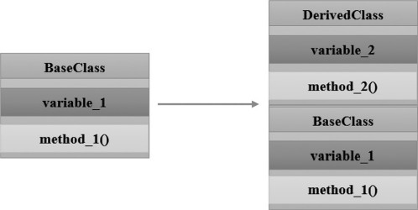
Inheritance
derived class inherits properties from base class
derived class
based class

Slide 127
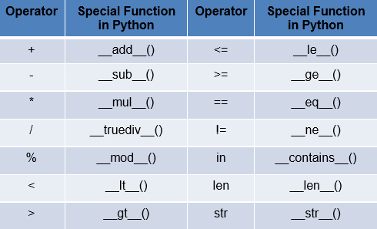
Polymorphism
implementing same method in different context.
method with same name implementing different way
+

Slide 128
For Instance
Institution:
Faculty Details
Students Details
Non Faculty Details
Other Details
Personal Details : : Name , DOB, Address
Faculty Details : Designation, salary, Attendence
Students Details : Progress, Attendence
Non Faculty Details : Designation, salary, Attendence

Slide 129
class Point:
def init (self,a=0,b=0):
self.x=a
self.y=b
def str (self):
return "(%d,%d)"%(self.x, self.y)
def add (self, p2):
p3=Point()
p3.x=self.x+p2.x
p3.y=self.y+p2.y
return p3
p1=Point(10,20)
p2=Point()
print("P1 is:",p1)
print("P2 is:",p2)
p4=p1+p2
print("Sum is:",p4)

Slide 130
Key points to remember
Create a Class : class MyClass:
Create Object : p1 = MyClass()
The __init__() :
the built-in __init__() function every class
which is always executed when the class is being initiated
We use to assign values to object properties
Object Methods : p1.myfunc()
The self Parameter :
reference to the current instance of the class
Modify Object Properties : p1.age = 40
Delete Object Properties : del p1.age
delete properties on objects by using the del keyword
Delete Objects : del p1
delete objects by using the del keyword
The pass Statement :
Class cannot be empty
For some reason have a class definition with no content
class Person: pass

Slide 131
Self Parameter
class Person: def __init__(mysillyobject, name, age): mysillyobject.name = name mysillyobject.age = age def myfunc(abc): print("Hello my name is " + abc.name)
p1 = Person("John", 36)
p1.myfunc()

Slide 132
Class
Syntax:
class class_name :
---------
----------
data
---------
-----------
function1
function2
...........
............
data
functions
syntax:
object.name=class_name()
student
roll_no name
write read

Slide 133
Class
class Student:
Student_RollNo=10
Student_Name=“John”
functions
data
functions
syntax:
object.name=class_name()
student
roll_no name
write read

Slide 134
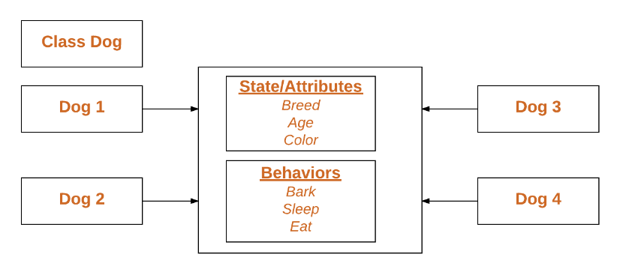
class Dog:
# A simple class
# attribute
attr1 = "mammal"
attr2 = "dog"
# A sample method
def fun(self):
print("I'm a", self.attr1)
print("I'm a", self.attr2)
# Driver code
# Object instantiation
Rodger = Dog()
# Accessing class attributes
# and method through objects
print(Rodger.attr1)
Rodger.fun()

Slide 135
example:
self: implict instance
#example for simple class
class student:
roll_no=77
name="sukshma"
branch="cse"
def read(self):
print("reading...")
s1=student()
print("roll_no:",s1.roll_no)
print("Name:",s1.name)
print("branch:",s1.branch)
s1.read()
-------
roll_no: 77
Name: sukshma
branch: cse
reading...

Slide 136
example 2
#example for simple class
class student:
roll_no=77
name="sukshma"
branch="cse"
def read(self):
rollno=5
print("rollno:",rollno)
print("reading...")
s1=student()
print("roll_no:",s1.roll_no)
print("Name:",s1.name)
print("branch:",s1.branch)
s1.read()
----
output:
???

Slide 137
example3:
#example for simple class
class student:
roll_no=77
name="sukshma"
branch="cse"
def read(self):
rollno=5
print("rollno:",rollno)
print("instance variable",self.roll_no)
print("reading...")

Slide 138
example 3(conti..)
s1=student()
print("roll_no:",s1.roll_no)
print("Name:",s1.name)
print("branch:",s1.branch)
s1.read()
----------------
output:roll_no: 77
Name: sukshma
branch: cse
rollno: 5
instance variable 77
reading...

Slide 139
example 4:
#example for simple class
class student:
roll_no=77
name="sukshma"
branch="cse"
def read(self):
rollno=5
print("rollno:",rollno)

Slide 140
conti..
print("instance variable",self.roll_no)
print("reading...")
def write(self):
print("writing..")
s1=student()
print("roll_no:",s1.roll_no)
print("Name:",s1.name)
print("branch:",s1.branch)
s1.read()
s1.write()

Slide 141
Programs:
print("EC department {0} ‘D’ section {college}“.format("6", college="RNSIT"))
ls= list()
while (True):
x= input('Enter a number: ')
if x== 'done‘:
break
x= float(x)
ls.append(x)
average = sum(ls) / len(ls)
print('Average:', average)

Slide 142
my_list = ['p','r','o','b','l','e','m']
print('poped element is:',my_list.pop())
print(my_list)
print('poped element is:',my_list.pop(1))
print(my_list)
names ={'chuck':1,'annie':42,'jan':100}
for k, v in names.items():
print(k, v)

